Slide 1
CS 61C: Great Ideas in Computer Architecture (Machine Structures) Warehouse-Scale Computing, MapReduce, and Spark
Instructors:
John Wawrzynek & Vladimir Stojanovic
http://inst.eecs.berkeley.edu/~cs61c/

Slide 2
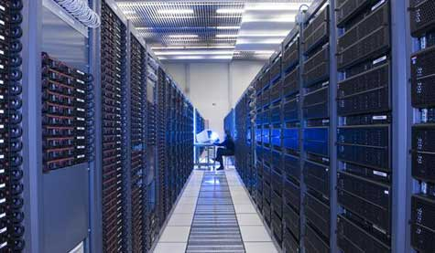

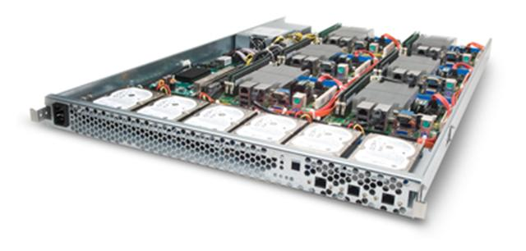
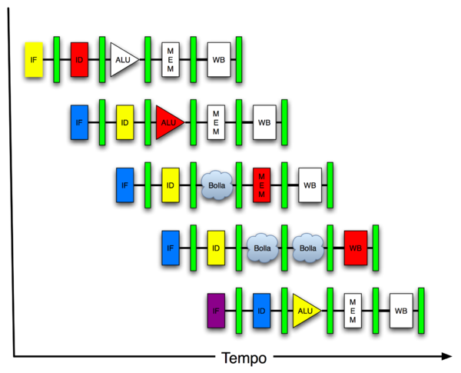
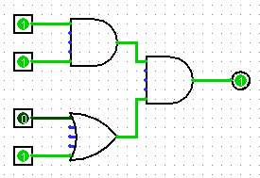
New-School Machine Structures (It’s a bit more complicated!)
Software Hardware
Parallel Requests
Assigned to computer
e.g., Search “cats”
Parallel Threads
Assigned to core
e.g., Lookup, Ads
Parallel Instructions
>1 instruction @ one time
e.g., 5 pipelined instructions
Parallel Data
>1 data item @ one time
e.g., Deep Learning for image classification
Hardware descriptions
All gates @ one time
Programming Languages
Warehouse Scale Computer
Smart Phone
Harness Parallelism &
Achieve High Performance
Computer
Core
…
Core
Memory (Cache)
Input/Output
Core
Instruction Unit(s)
Functional
Unit(s)
A₀+B₀
A₁+B₁
A₂+B₂
A₃+B₃
Cache Memory
Logic Gates

Slide 3
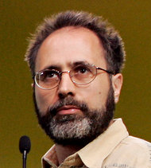
In the news
Google disclosed that it continuously uses enough electricity to power 200,000 homes, but it says that in doing so, it also makes the planet greener.
Average energy use per typical user per month is same as running a 60-watt bulb for 3 hours (180 watt-hours).
Urs Hoelzle, Google SVP
Co-author of today’s reading
http://www.nytimes.com/2011/09/09/technology/google-details-and-defends-its-use-of-electricity.html

Slide 4
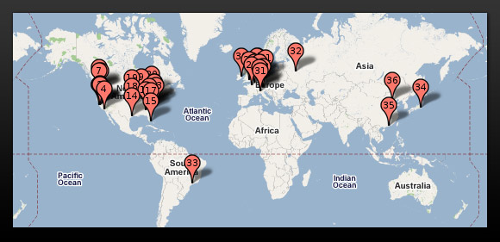
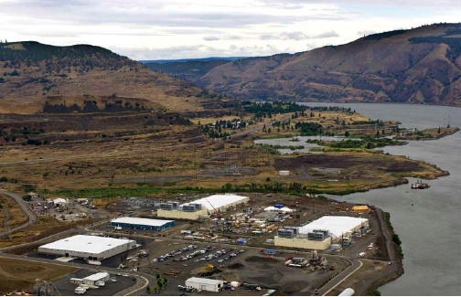
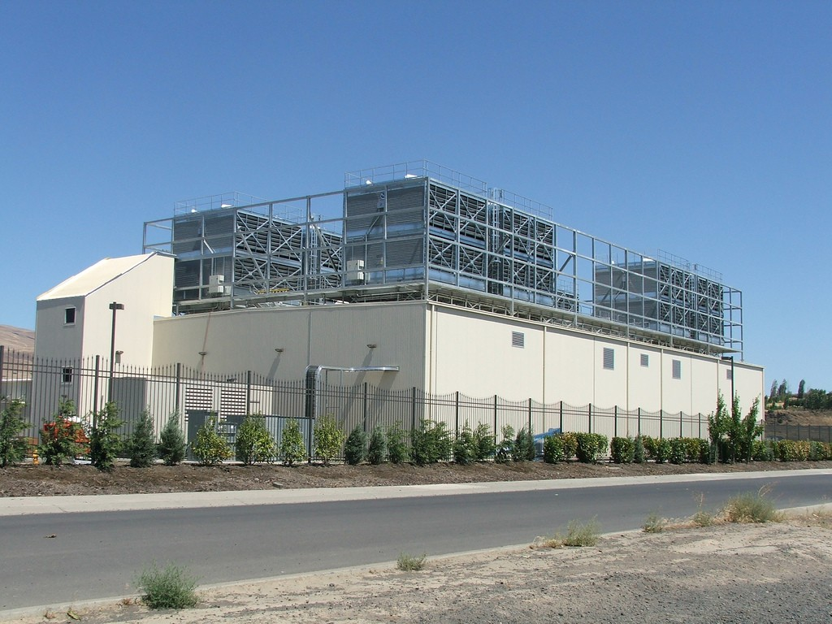
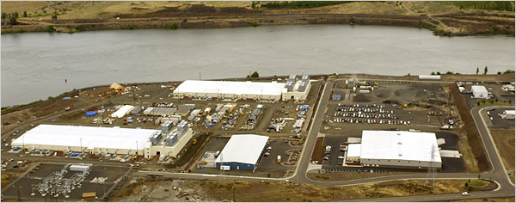
Google’s WSCs
Ex: In Oregon

Slide 5
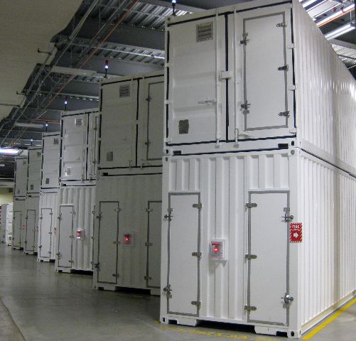
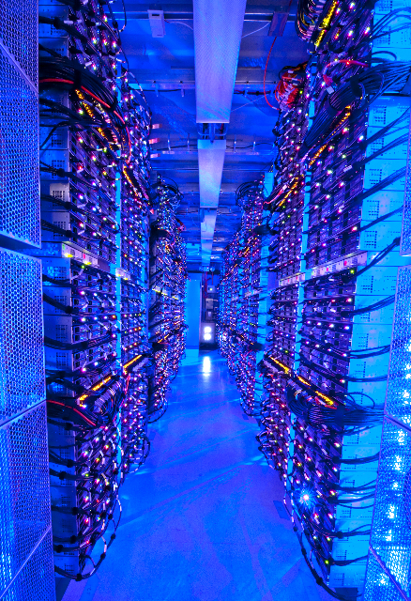
Containers in WSCs
Inside WSC
Inside Container

Slide 6
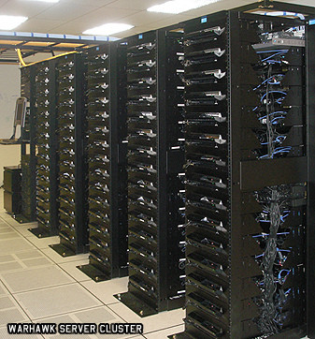
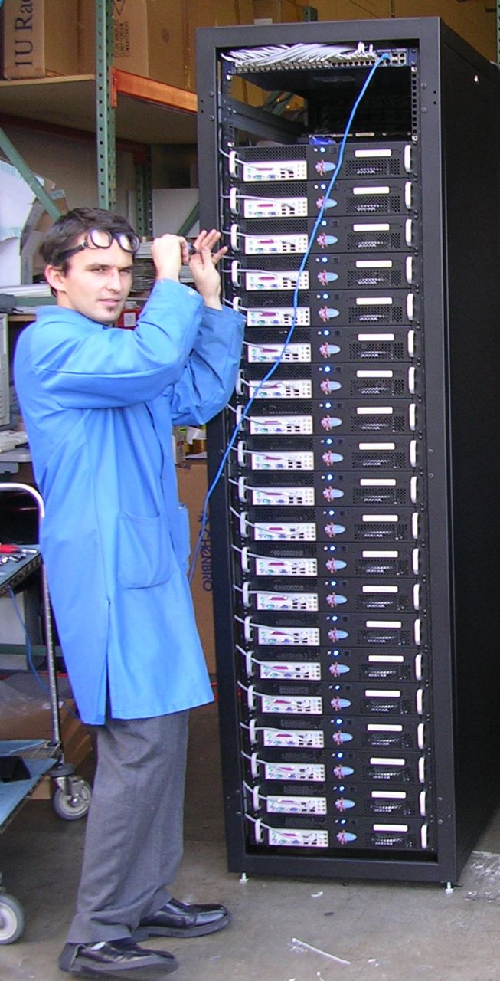
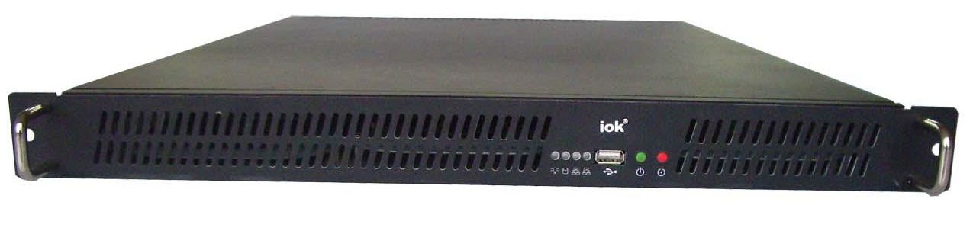
Server, Rack, Array

Slide 7
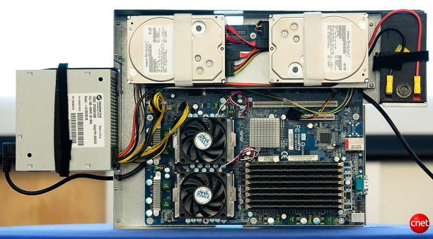
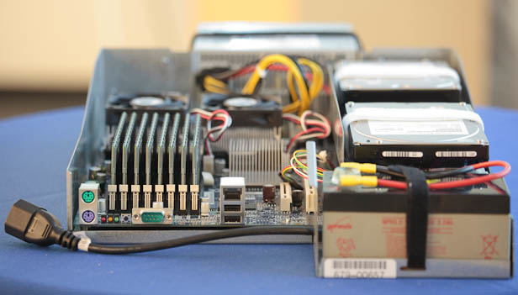
Google Server Internals
Google Server
Notes:
Most companies buy servers from the likes of Dell, Hewlett-Packard, IBM, or Sun Microsystems. But Google, which has hundreds of thousands of servers and considers running them part of its core expertise, designs and builds its own. Ben Jai, who designed many of Google's servers, unveiled a modern Google server before the hungry eyes of a technically sophisticated audience.
Google's big surprise: each server has its own 12-volt battery to supply power if there's a problem with the main source of electricity. The company also revealed for the first time that since 2005, its data centers have been composed of standard shipping containers--each with 1,160 servers and a power consumption that can reach 250 kilowatts.
It may sound geeky, but a number of attendees--the kind of folks who run data centers packed with thousands of servers for a living--were surprised not only by Google's built-in battery approach, but by the fact that the company has kept it secret for years. Jai said in an interview that Google has been using the design since 2005 and now is in its sixth or seventh generation of design.
Read more: http://news.cnet.com/8301-1001_3-10209580-92.html#ixzz0yo8bhTOH

Slide 8
Warehouse-Scale Computers
Datacenter
Collection of 10,000 to 100,000 servers
Networks connecting them together
Single gigantic machine
Very large applications (Internet service): search, email, video sharing, social networking
Very high availability
“…WSCs are no less worthy of the expertise of computer systems architects than any other class of machines” Barroso and Hoelzle, 2009

Slide 9
Unique to WSCs
Ample Parallelism
Request-level Parallelism: ex: Web search
Data-level Parallelism: ex: Image classifier training
Scale and its Opportunities/Problems
Scale of economy: low per-unit cost
Cloud computing: rent computing power with low costs (ex: AWS)
High # of failures
ex: 4 disks/server, annual failure rate: 4% → WSC of 50,000 servers: 1 disk fail/hour
Operation Cost Count
Longer life time (>10 years)
Cost of equipment purchases << cost of ownership

Slide 10
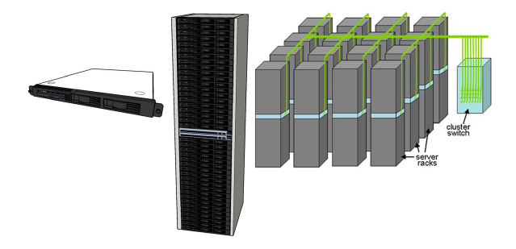
WSC Architecture
1U Server:
8 cores,
16 GB DRAM,
4x1 TB disk
Array (aka cluster):
16-32 racks
Expensive switch
(10X bandwidth → 100x cost)
Rack:
40-80 severs,
Local Ethernet (1-10Gbps) switch
(30$/1Gbps/server)

Slide 11
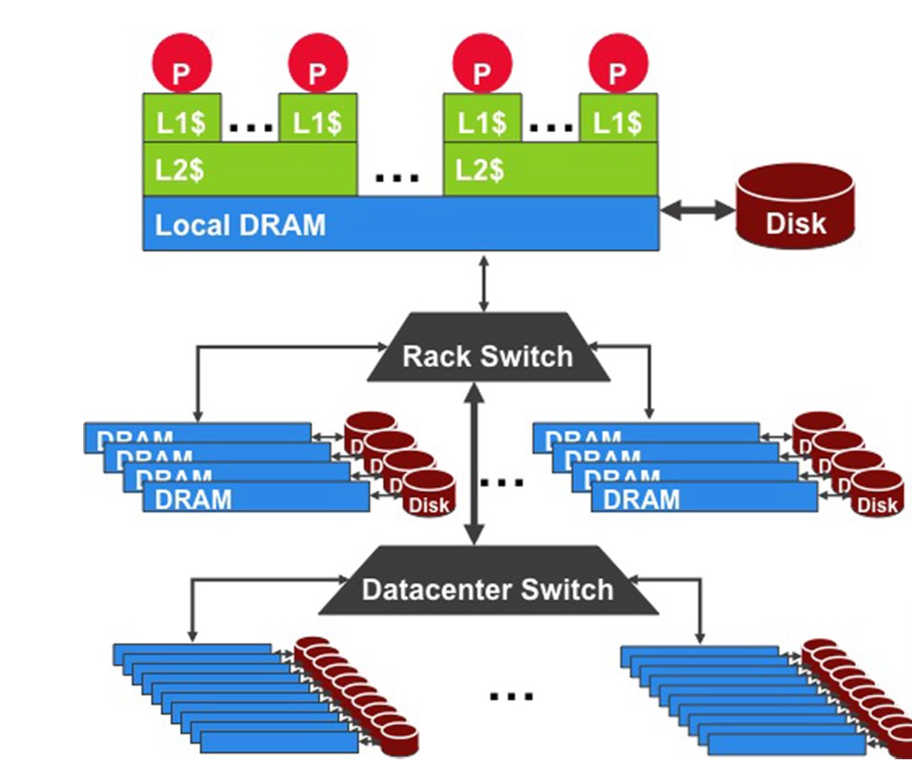
WSC Storage Hierarchy
Lower latency to DRAM in another server than local disk
Higher bandwidth to local disk than to DRAM in another server
1U Server:
DRAM: 16GB, 100ns, 20GB/s
Disk: 2TB, 10ms, 200MB/s
Rack(80 severs):
DRAM: 1TB, 300us, 100MB/s
Disk: 160TB, 11ms, 100MB/s
Array(30 racks):
DRAM: 30TB, 500us, 10MB/s
Disk: 4.80PB, 12ms, 10MB/s

Slide 12
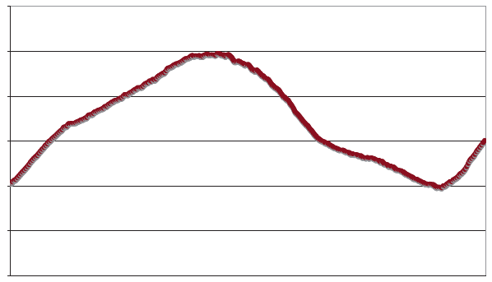
Workload Variation
Workload
2X
Midnight
Noon
Midnight
Online service: Peak usage 2X off-peak

Slide 13
Impact on WSC software
Latency, bandwidth → Performance
Independent data set within an array
Locality of access within server or rack
High failure rate → Reliability, Availability
Preventing failures is expensive
Cope with failures gracefully
Varying workloads → Availability
Scale up and down gracefully
More challenging than software for single computers!

Slide 14
Power Usage Effectiveness
Energy efficiency
Primary concern in the design of WSC
Important component of the total cost of ownership
Power Usage Effectiveness (PUE):
A power efficiency measure for WSC
Not considering efficiency of servers, networking
Perfection = 1.0
Google WSC’s PUE = 1.2
Total Building Power
IT equipment Power

Slide 15
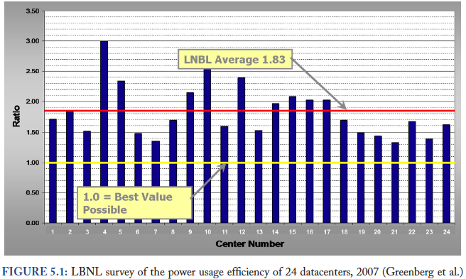
PUE in the Wild (2007)

Slide 16
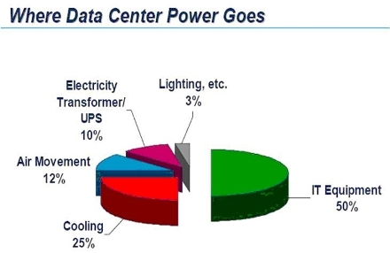

Slide 17
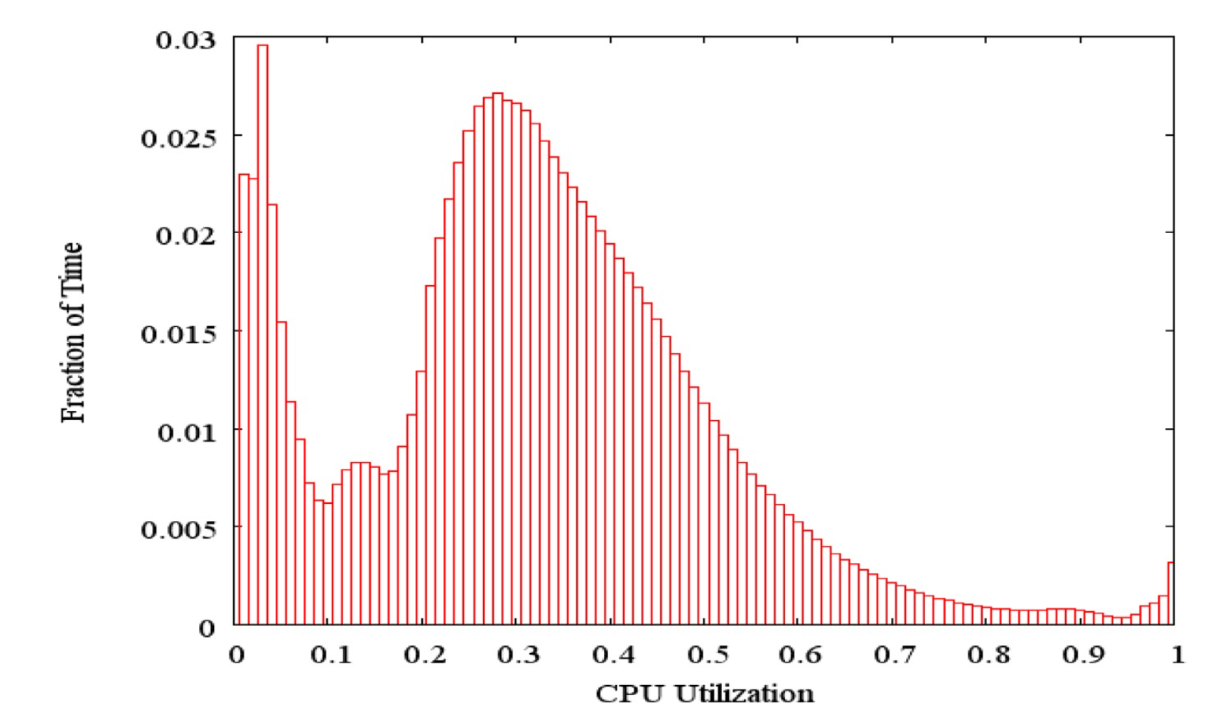
Load Profile of WSCs
Average CPU utilization of 5,000 Google servers, 6 month period
Servers rarely idle or fully utilized, operating most of the time at 10% to 50% of their maximum utilization

Slide 18
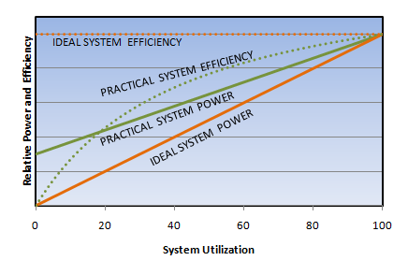
Energy-Proportional Computing: Design Goal of WSC
Energy = Power x Time, Efficiency = Computation / Energy
Desire:
Consume almost no power when idle (“Doing nothing well”)
Gradually consume more power as the activity level increases

Slide 19
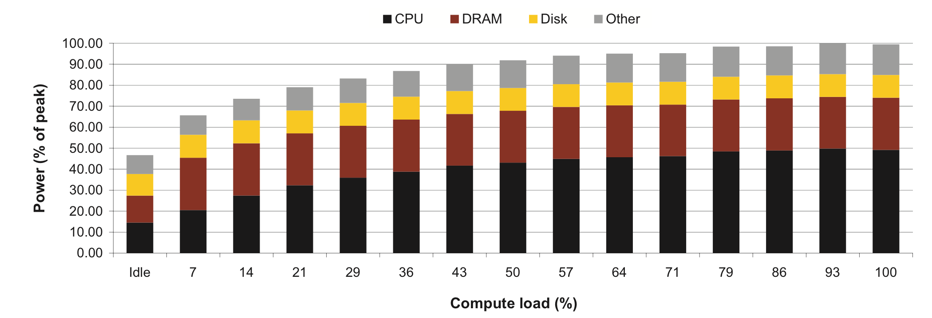
Cause of Poor Energy Proportionality
CPU: 50% at peek, 30% at idle
DRAM, disks, networking: 70% at idle!
Need to improve the energy efficiency of peripherals

Slide 20
Agenda
Warehouse Scale Computing
Request-level Parallelism
e.g. Web search
Administrivia & Clickers/Peer Instructions
Data-level Parallelism
Hadoop, Spark
MapReduce
(Bonus) Convolutional Neural Networks

Slide 21
Request-Level Parallelism (RLP)
Hundreds of thousands of requests per sec.
Popular Internet services like web search, social networking, …
Such requests are largely independent
Often involve read-mostly databases
Rarely involve read-write sharing or synchronization across requests
Computation easily partitioned across different requests and even within a request

Slide 22
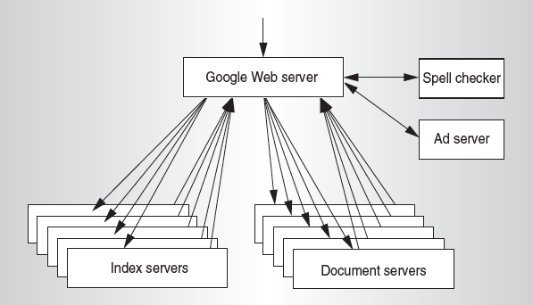
Google Query-Serving Architecture

Slide 23
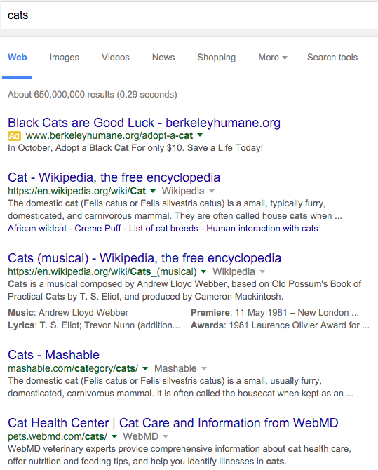

Anatomy of a Web Search

Slide 24
Anatomy of a Web Search (1/3)
Google “cats”
Direct request to “closest” Google WSC
Front-end load balancer directs request to one of many arrays (cluster of servers) within WSC
Within array, select one of many Goggle Web Servers (GWS) to handle the request and compose the response pages
GWS communicates with Index Servers to find documents that contains the search word, “cats”
Return document list with associated relevance score

Slide 25
Anatomy of a Web Search (2/3)
In parallel,
Ad system: run ad auction for bidders on search terms
Use docids (Document IDs) to access indexed documents
Compose the page
Result document extracts (with keyword in context) ordered by relevance score
Sponsored links (along the top) and advertisements (along the sides)

Slide 26
Anatomy of a Web Search (3/3)
Implementation strategy
Randomly distribute the entries
Make many copies of data (a.k.a. “replicas”)
Load balance requests across replicas
Redundant copies of indices and documents
Breaks up search hot spots, e.g. “Taylor Swift”
Increases opportunities for request-level parallelism
Makes the system more tolerant of failures

Slide 27
Agenda
Warehouse Scale Computing
Request-level Parallelism
e.g. Web search
Administrivia & Clickers/Peer Instructions
Data-level Parallelism
Hadoop, Spark
MapReduce
Convolutional Neural Networks

Slide 28
Clickers:
What did you think of the midterm exam?
A: Very difficult
E: Too easy

Slide 29
Administrivia
Please go to their own lab this week for checkoff.
If you wait to get checked off in the Monday lab, there may be too many people for everyone to be checked off.
We expect to have MT2 graded by Monday 11/23
Project 4 out
Image processing performance optimization
Parallelization with SSE (DLP) & openMP (TLP)
due 11/18 (next Wednesday)

Slide 30
Clicker/Peer Instruction: Which Statement is True
A: Idle servers consume almost no power.
B: Disks will fail once in 20 years, so failure is not a problem of WSC.
C: The search requests of the same keyword from different users are dependent.
D: More than half of the power of WSCs goes into cooling.
E: WSCs contain many copies of data.

Slide 31
Agenda
Warehouse Scale Computing
Administrivia & Clickers/Peer Instructions
Request-level Parallelism
e.g. Web search
Data-level Parallelism
MapReduce
Hadoop, Spark
(Bonus) Convolutional Neural Networks

Slide 32
Data-Level Parallelism (DLP)
SIMD
Supports data-level parallelism in a single machine
Additional instructions & hardware
e.g. Matrix multiplication in memory
DLP on WSC
Supports data-level parallelism across multiple machines
MapReduce & scalable file systems
e.g. Training CNNs with images across multiple disks

Slide 33
What is MapReduce?
Simple data-parallel programming model and implementation for processing large dataset
Users specify the computation in terms of
a map function, and
a reduce function
Underlying runtime system
Automatically parallelize the computation across large scale clusters of machines.
Handles machine failure
Schedule inter-machine communication to make efficient use of the networks
Jeffrey Dean and Sanjay Ghemawat, “MapReduce: Simplified Data Processing on Large Clusters,” 6th USENIX Symposium on Operating Systems Design and Implementation, 2004. (optional reading, linked on course homepage – a digestible CS paper at the 61C level)

Slide 34
What is MapReduce used for?
At Google:
Index construction for Google Search
Article clustering for Google News
Statistical machine translation
For computing multi-layers street maps
At Yahoo!:
“Web map” powering Yahoo! Search
Spam detection for Yahoo! Mail
At Facebook:
Data mining
Ad optimization
Spam detection

Slide 35
Inspiration: Map & Reduce Functions, ex: Python
1
2
3
4
Calculate :
A = [1, 2, 3, 4]
def square(x):
return x * x
def sum(x, y):
return x + y
reduce(sum,
map(square, A))
1
4
9
16
5
25
30

Slide 36
MapReduce Programming Model
Map: (in_key, in_value) → list(interm_key, interm_val)
map(in_key, in_val):
// DO WORK HERE emit(interm_key,interm_val)
Slice data into “shards” or “splits” and distribute to workers
Compute set of intermediate key/value pairs
Reduce: (interm_key, list(interm_value)) → list(out_value)
reduce(interm_key, list(interm_val)):
// DO WORK HERE
emit(out_key, out_val)
Combines all intermediate values for a particular key
Produces a set of merged output values (usually just one)

Slide 37
MapReduce Word Count Example
Task of counting the number of occurrences of each word in a large collection of documents.
User-written Map function reads the document data and
parses out the words. For each word, it writes the (key, value) pair of (word, 1). That is, the word is treated as the intermediate key and the associated value of 1 means that we saw the word once.
Map phase: (doc name, doc contents) → list(word, count)
// “I do I learn” → [(“I”,1),(“do”,1),(“I”,1),(“learn”,1)]
map(key, value):
for each word w in value:
emit(w, 1)

Slide 38
MapReduce Word Count Example
Task of counting the number of occurrences of each word in a large collection of documents.
The intermediate data is then sorted by MapReduce by keys and the user’s Reduce function is called for each unique key. In this case, Reduce is called with a list of a "1" for each occurrence of the word that was parsed from the document. The function adds them up to generate a total word count for that word.
Reduce phase: (word, list(counts)) → (word, count_sum)
// (“I”, [1,1]) → (“I”,2)
reduce(key, values):
result = 0
for each v in values:
result += v
emit(key, result)

Slide 39
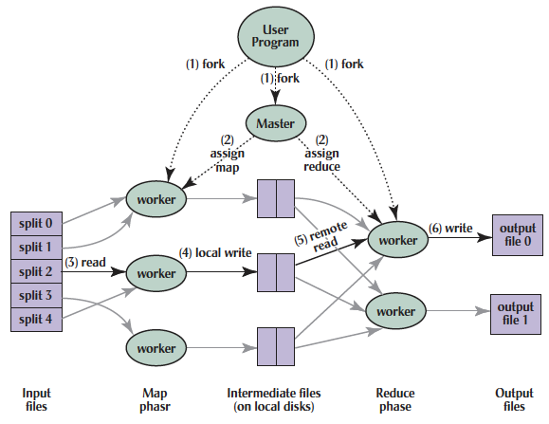
MapReduce Implementation

Slide 40
MapReduce Execution
(1) Split inputs, start up programs on a cluster of machines

Slide 41
MapReduce Execution
(2) Assign map & reduce tasks to idle workers

Slide 42
MapReduce Execution
(3) Perform a map task, generate intermediate key/value pairs
(4) Write to the buffers

Slide 43
MapReduce Execution
(5) Read intermediate key/value pairs, sort them by its key.

Slide 44
MapReduce Execution
(6) Perform a reduce task for each intermediate key,
write the result to the output files

Slide 45

Big Data Framework: Hadoop & Spark
Apache Hadoop
Open-source MapReduce Framework
Hadoop Distributed File System (HDFS)
MapReduce Java APIs
Apache Spark
Fast and general engine for large-scale data processing.
Originally developed in the AMP lab at UC Berkeley
Running on HDFS
Provides Java, Scala, Python APIs for
Database
Machine learning
Graph algorithm

Slide 46
WordCount in Hadoop’s Java API

Slide 47
Word Count in Spark’s Python API
// RDD: primary abstraction of a distributed collection of items
file = sc.textFile(“hdfs://…”)
// Two kinds of operations:
// Actions: RDD → Value
// Transformations: RDD → RDD
// e.g. flatMap, Map, reduceByKey
file.flatMap(lambda line: line.split())
.map(lambda word: (word, 1))
.reduceByKey(lambda a, b: a + b)

Slide 48
Summary
Warehouse Scale Computers
New class of computers
Scalability, energy efficiency, high failure rate
Request-level parallelism
e.g. Web Search
Data-level parallelism on a large dataset
MapReduce
Hadoop, Spark

